Slide 1
Predictive control 16 MATLAB code for prediction
Anthony Rossiter

Slide 2
Introduction
The first chapter in this video series on MPC has focussed largely on open-loop prediction.
Viewers may find it convenient to have some simple MATLAB code for finding these predictions.
This video gives an overview of suitable code which is available on the website.
The code is written to be simple and straightforward so that someone with relative elementary MATLAB skills can easily follow and edit as required. That is, it is not designed to be optimised for computational efficiency or speed.

Slide 3
State space models
A common discrete state space model is given as:
This video series will restrict itself to this form and assume, for convenience, that D=0.

Slide 4
Compact output prediction notation
Output predictions for a state space model are summarised as follows:
Note that the definitions of P,H are the same for deviation variables, so here the focus is solely on finding P and H.

Slide 5
MATLAB code
Matrices required are P, H, L, P_{x}, H_{x}.
These depend upon the model parameters A,B,C and the horizon n (assume D=0).
Code is provided in the file (folder independent model MPC)
video16example1.m
[H,P,L] = imgpc_predmat(A,B,C,D,ny)
Includes a SISO and MIMO example.
Move to MATLAB now to illustrate.

Slide 6
CARIMA model output predictions
The earlier videos developed the following results.

Slide 7
MATLAB code
Matrices required at H, P, Q.
These depend upon the model parameters a(z),b(z) and the horizon n.
Code is provided in the file (GPC folder)
video16example2.m
[H,P,Q] = mpc_predmat(a,b,ny)
[H,P,Q] = mpc_predmat_toeplitz(a,b,ny)
Includes a SISO and MIMO example.
Move to MATLAB now to illustrate.

Slide 8
Summary
It is common to use discrete models for prediction.
This video demonstrates some MATLAB code available to form unbiased n-step ahead predictions.
Code is given for state space models and for transfer function models.
Code is available on the website which gives an overview of all the videos.

Slide 9



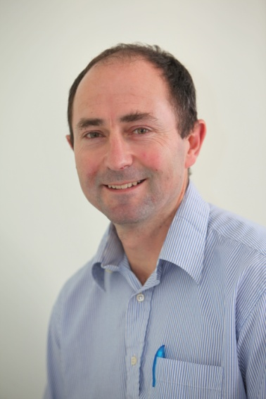
Anthony Rossiter
Department of Automatic Control and Systems Engineering
University of Sheffield
www.shef.ac.uk/acse
© 2014 University of Sheffield
This work is licensed under the Creative Commons Attribution 2.0 UK: England & Wales Licence. To view a copy of this licence, visit http://creativecommons.org/licenses/by/2.0/uk/ or send a letter to: Creative Commons, 171 Second Street, Suite 300, San Francisco, California 94105, USA.
It should be noted that some of the materials contained within this resource are subject to third party rights and any copyright notices must remain with these materials in the event of reuse or repurposing.
If there are third party images within the resource please do not remove or alter any of the copyright notices or website details shown below the image.
(Please list details of the third party rights contained within this work.
If you include your institutions logo on the cover please include reference to the fact that it is a trade mark and all copyright in that image is reserved.)

